Slide 1
Smart Shop
Jad Kang – Project Manager Robert Orlando – QA testing Alex Durant – UI/UX Zacheary Vang – Frontend Developer Ryan Mcarthur – Backend Developer Jeremiah Davis – Backend Developer

Slide 2
What is it
Meal plan and shopping list creation tool, designed to make it easy to plan your meals for a week and shop for exactly what you need.

Slide 3
How it's changed
Initially only a shopping list generator
Now a meal plan creation tool. Browse recipes and plan out your meals for a week, then generating a list based on selected recipes.
Focus on being easy to use and accessible

Slide 4
Requirements
Simple and easy to use ui/ux
Login feature
Meal plan creation
Create days under meal plan
Criteria input
Recipe browsing
Shopping list generation

Slide 5
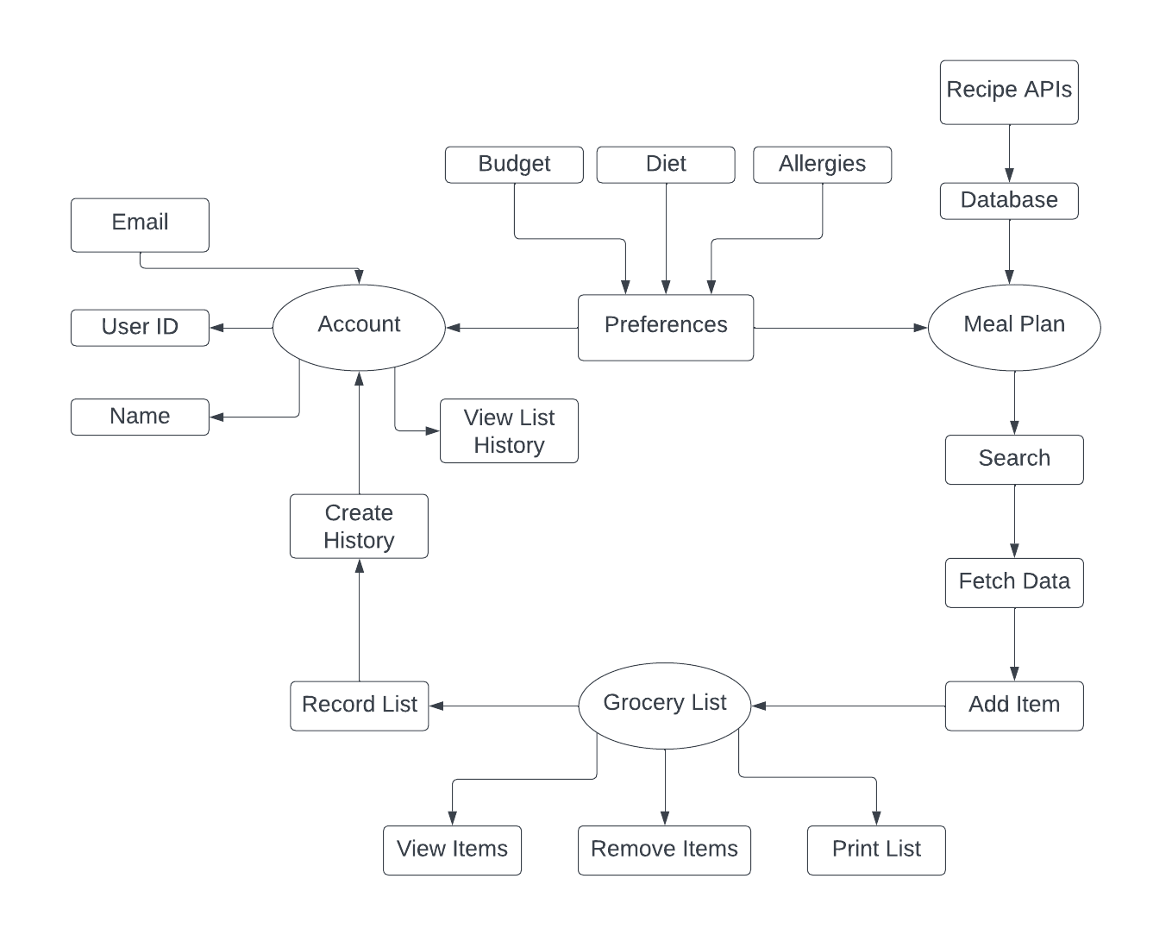

Slide 6
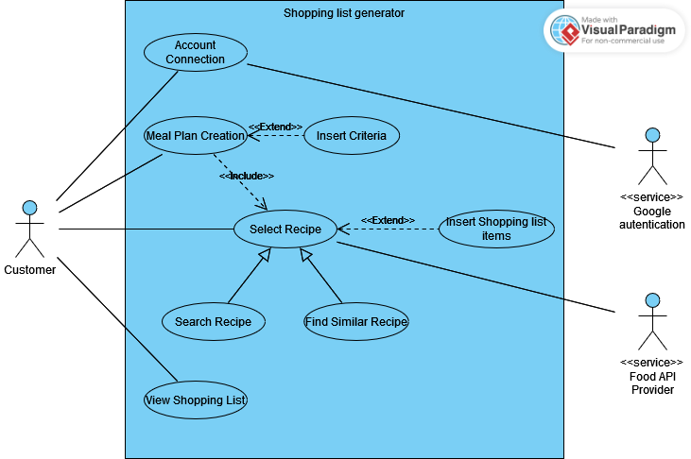

Slide 7
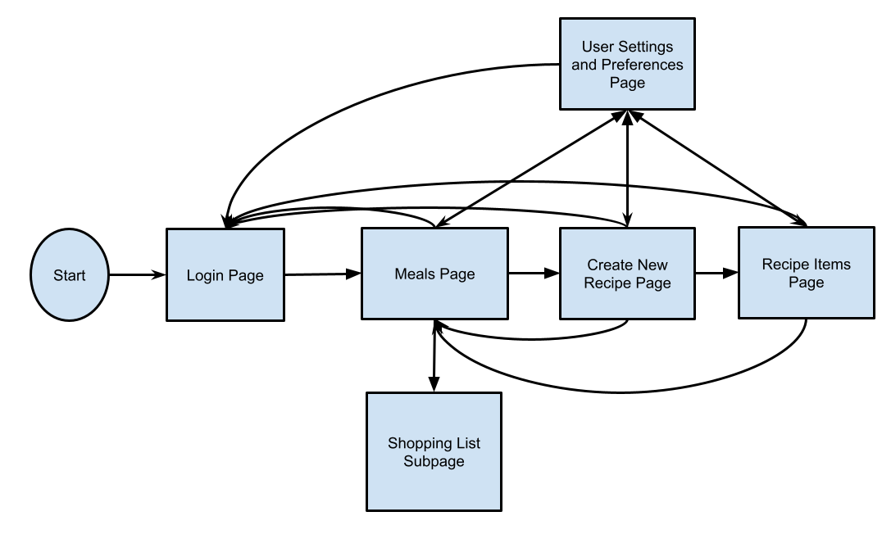
UI
https://www.figma.com/file/wCE3aianafLlOY3j8v9ASv/TestForCSCI150?type=design&node-id=86%3A266&mode=design&t=aQJR8J9hyRZvGsBF-1

Slide 8
Development

Slide 9
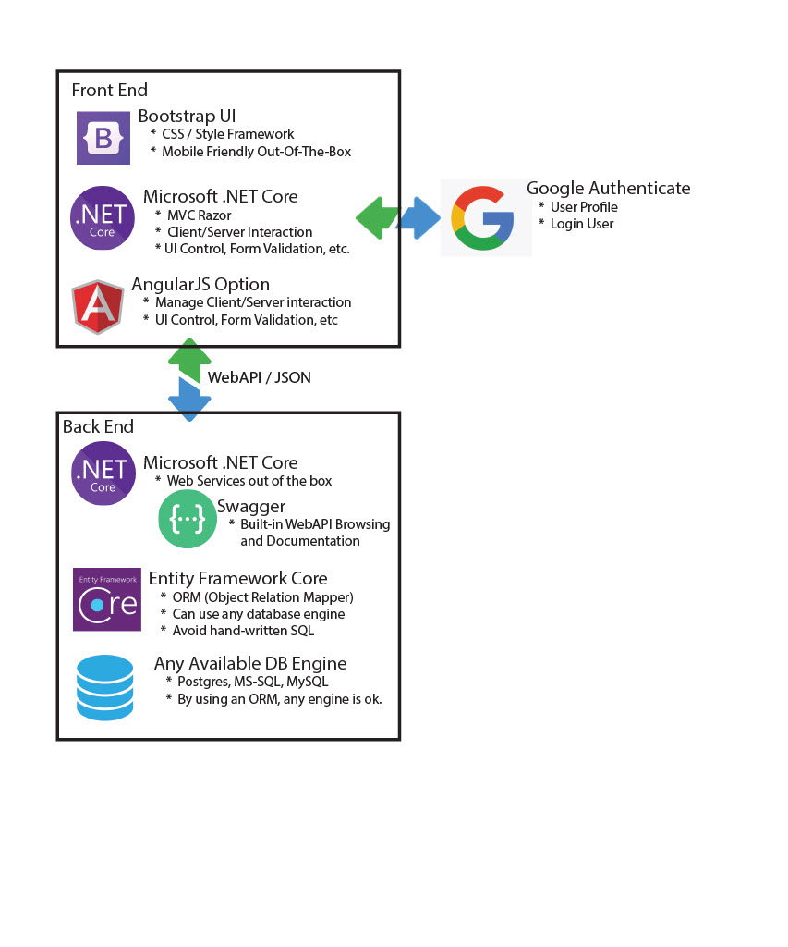

Slide 10
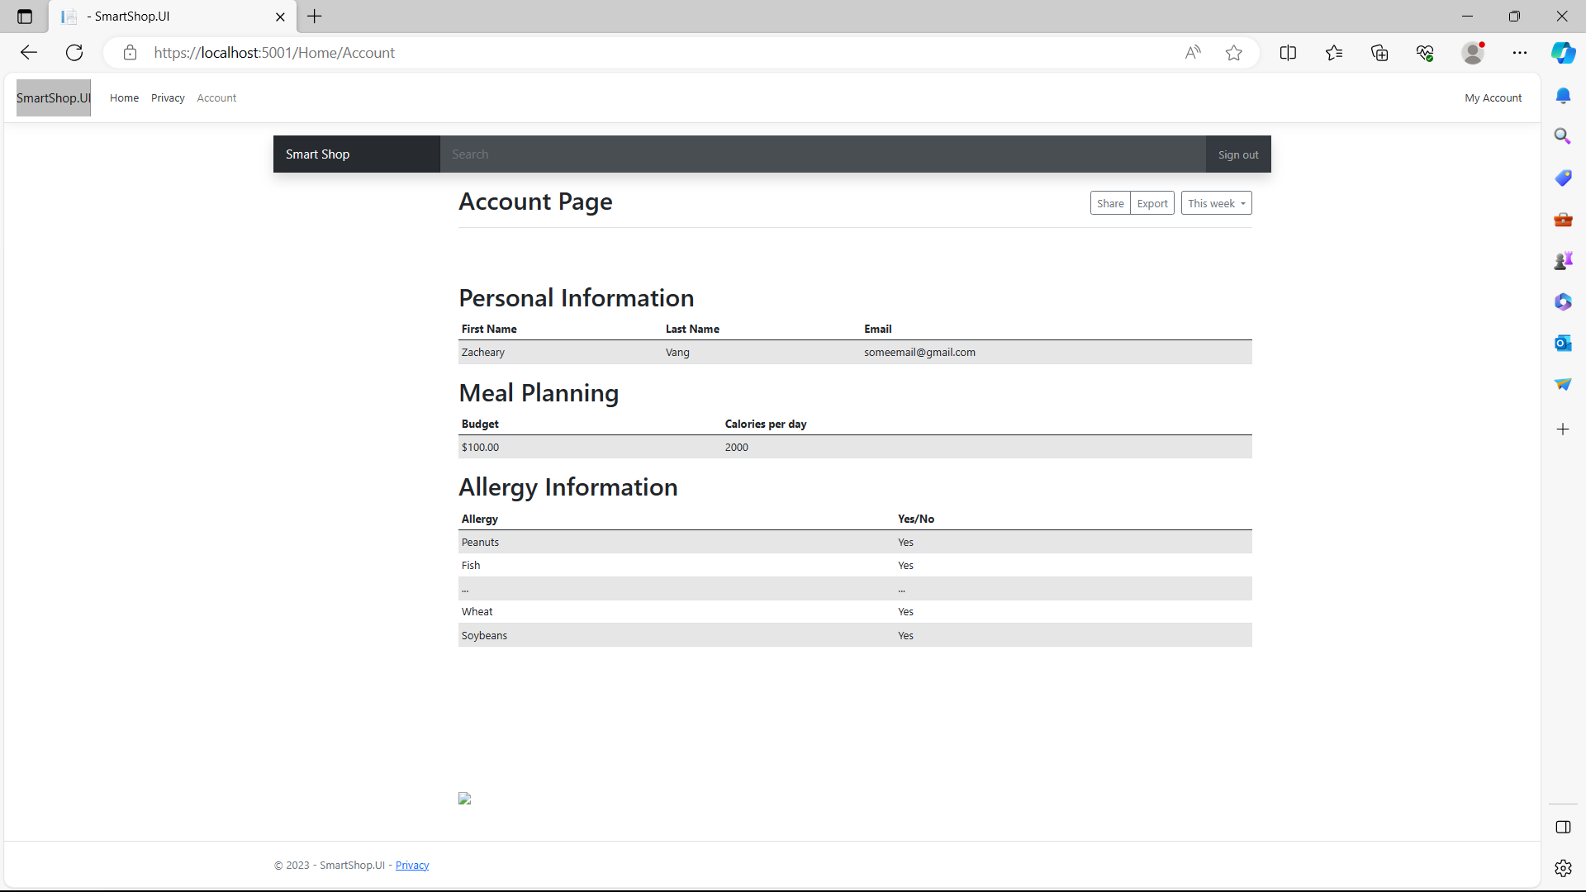
Frontend
Template for account page using bootstrap

Slide 11
Backend
Google authentication
Local user profile
Meal plan (partial)
Storing grocery item
Recipe ranking/review

Slide 12
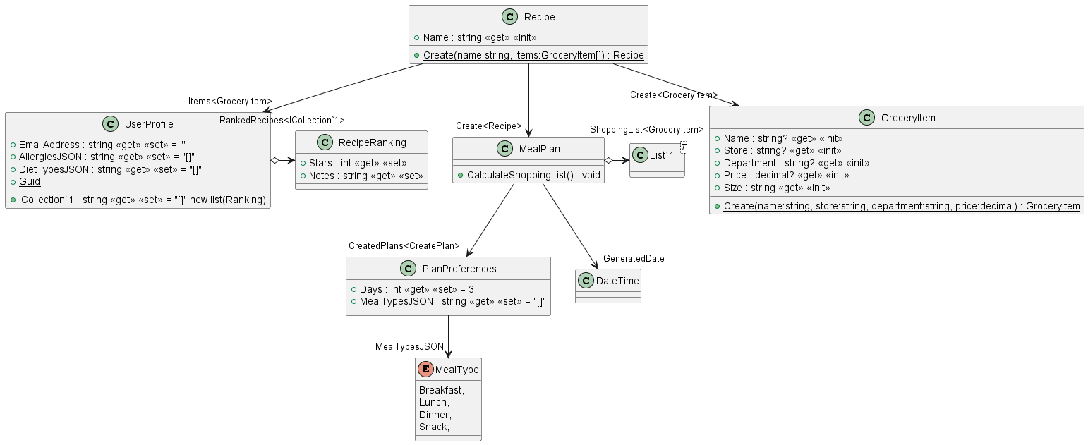

Slide 13
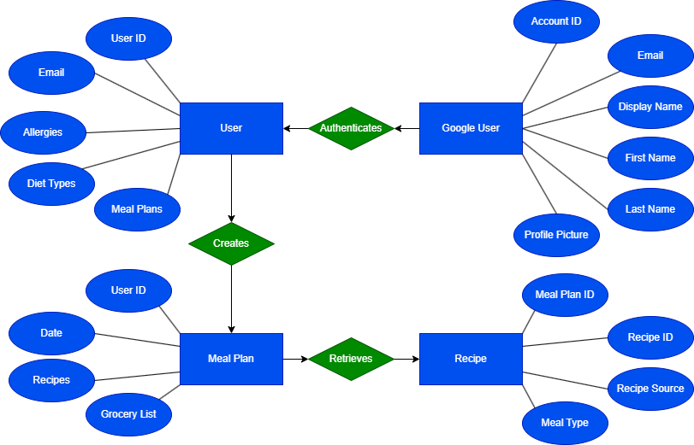

Slide 14
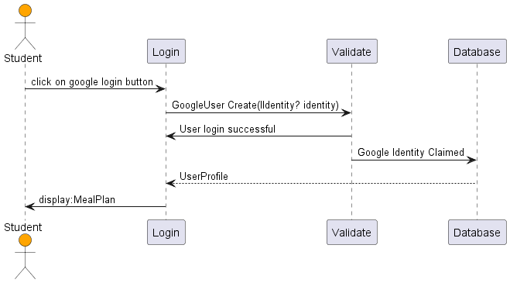

Slide 15
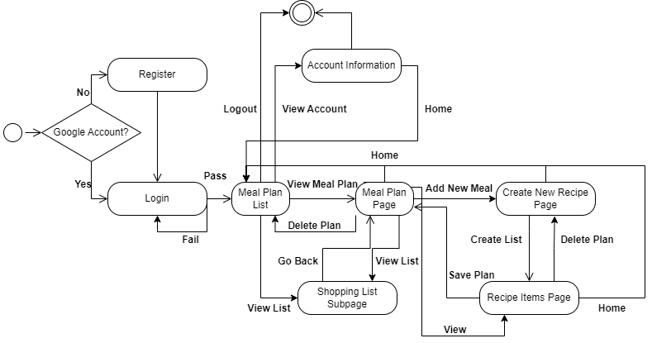

Slide 16
Current Plan
Continue development on frontend, connect frontend to backend, complete integration of apis, complete meal plan creation, form user profile, generate shopping list from recipes, add criteria.

